Slide 1
SQL Basics

Slide 2
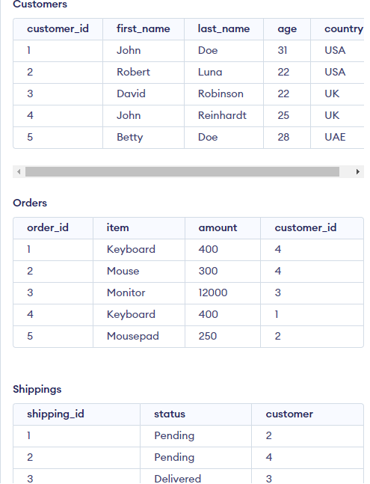
Data Base
Our database consists of 3 tables:
Customers
Orders
Shipping_id
Link:
https://www.programiz.com/sql/online-compiler/

Slide 3
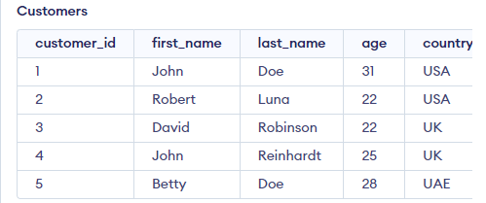
get all the data in table Customers
SELECT * FROM Customers
Output:
Original table

Slide 4
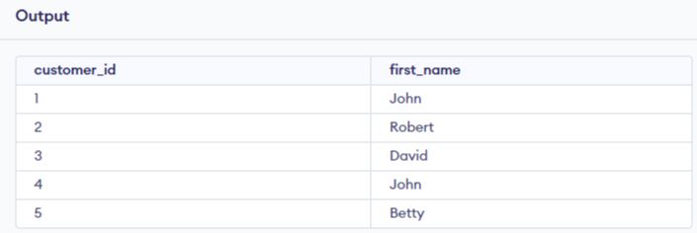
Get selected columns from table customer
SELECT customer_id,first_name FROM Customers;
Original table

Slide 5
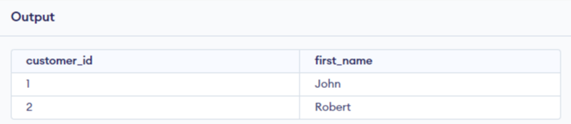
Get the first two rows from selected columns
SELECT customer_id,first_name FROM Customers LIMIT 2;
Original table

Slide 6
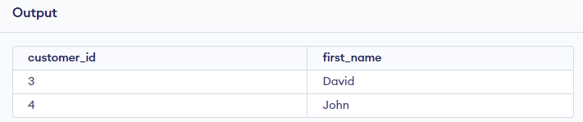
Get the first two rows after row number 2
SELECT customer_id,first_name FROM Customers LIMIT 2 OFFSET 2;
Original table

Slide 7
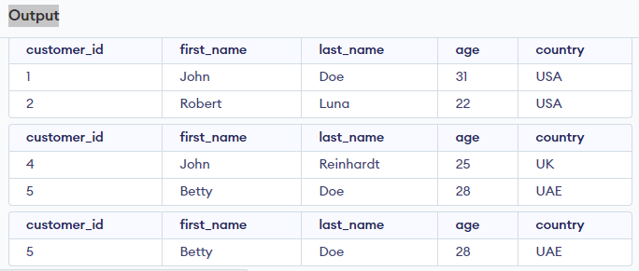
Using where to filter or search for data
SELECT * FROM Customers where country ="USA" ;
SELECT * FROM Customers where customer_id > 3;
SELECT * FROM Customers where customer_id > 3 and age > 26;
Original table

Slide 8
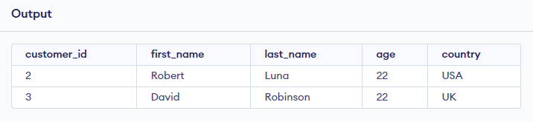
Using where with LIMIT
SELECT * FROM Customers where customer_id >=2 and age >=22 LIMIT 2;
Original table

Slide 9
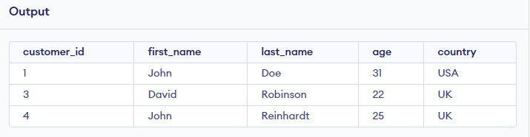
Using where with OR
SELECT * FROM Customers where first_name="John" OR first_name="David";
Original table

Slide 10
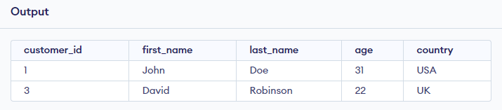
Using where with OR and LIMIT
SELECT * FROM Customers where first_name="John" OR first_name="David“ LIMIT 2;
Original table

Slide 11
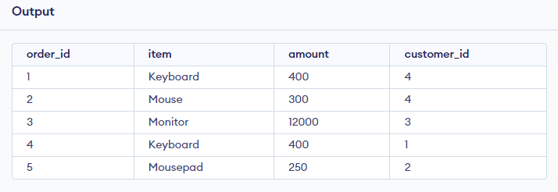
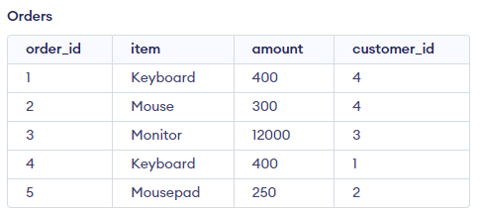
Using another table Orders
SELECT * FROM Orders;
Original table

Slide 12
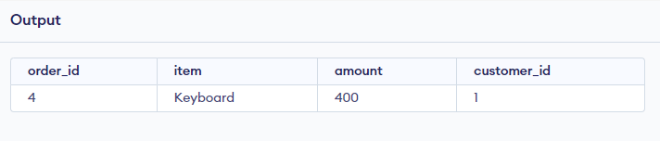
Using where in table Orders
SELECT * FROM Orders where item ="Keyboard" and order_id > 3;
Original table

Slide 13
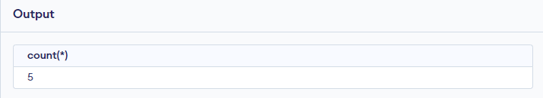
Using function COUNT
SELECT COUNT(*) FROM Customers;
Original table

Slide 14
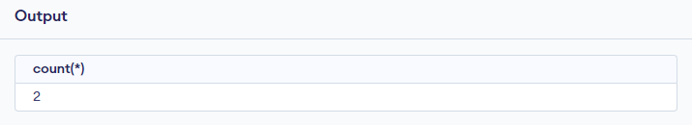
Using COUNT function with where
SELECT count(*) FROM Customers where first_name="John";
Original table

Slide 15
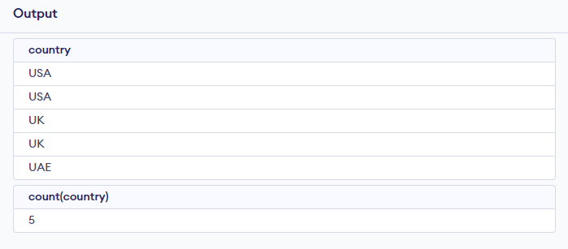
Problem: data duplication
SELECT country FROM Customers ;
SELECT count(country)FROM Customers ;
Original table

Slide 16
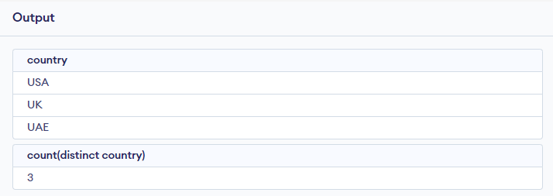
How to get unique data from column using DISTINCT ?
SELECT distinct country FROM Customers ;
SELECT count(distinct country)FROM Customers ;
Original table

Slide 17
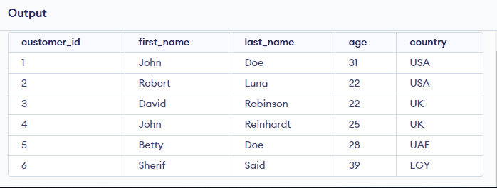
INSERT new data to Table customers
INSERT INTO Customers values(6,"Sherif","Said",39,"EGY");
SELECT * FROM Customers;
Original table

Slide 18
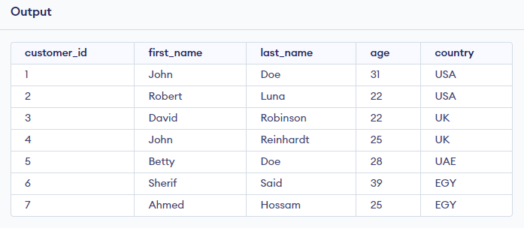
INSERT two rows to Table customers
INSERT INTO Customers values(6,"Sherif","Said",39,"EGY") , ("7","Ahmed","Hossam",25,"EGY");
SELECT * FROM Customers;
Original table

Slide 19
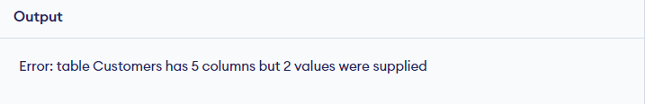
Problem: INSERT data to Table customers in specific columns
INSERT INTO Customers values(6,"Sherif") , ("7","Ahmed");
SELECT * FROM Customers;
Original table

Slide 20
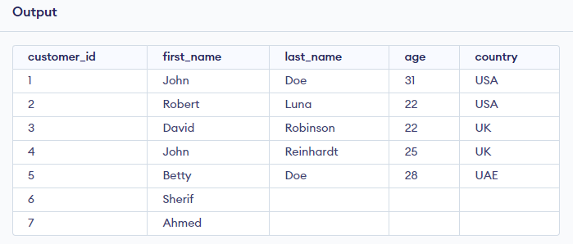
Solution 1: INSERT data to Table customers in specific columns
INSERT INTO Customers values(6,"Sherif",NULL,NULL,NULL) , ("7","Ahmed",NULL,NULL,NULL);
SELECT * FROM Customers;
Original table

Slide 21
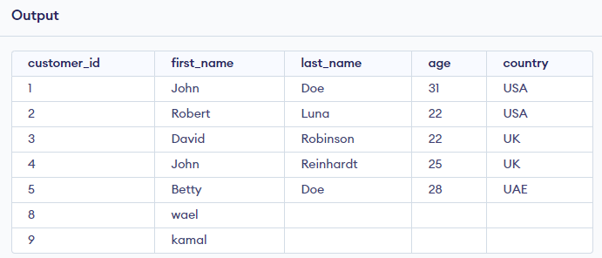
Solution 2: INSERT data to Table customers in specific columns
INSERT INTO Customers (customer_id , first_name) values (8,"wael") , (9,"kamal");
SELECT * FROM Customers;
Original table

Slide 22
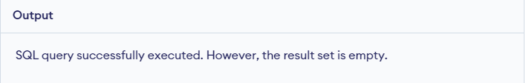
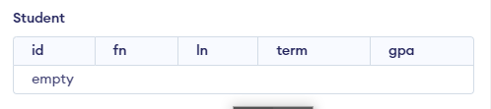
How to create new Table ?
Create TABLE student (id INTEGER ,fn TEXT ,ln TEXT ,term INTEGER ,gpa REAL);
SELECT * FROM student;
Original Table

Slide 23
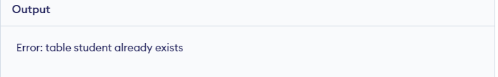
Problem : Try to Create same table again by mistake
Create TABLE student (id INTEGER ,fn TEXT ,ln TEXT ,term INTEGER ,gpa REAL);
SELECT * FROM student;
Original Table

Slide 24
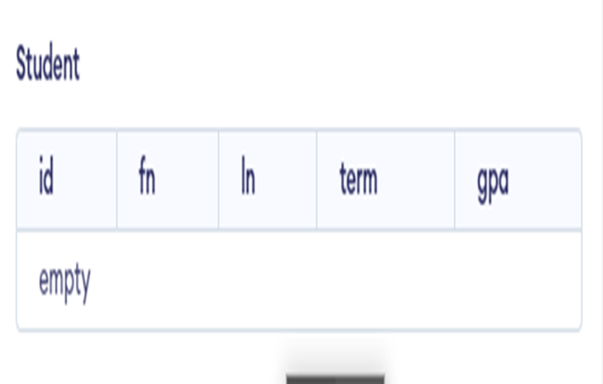
Solution : Try to Create same table again by mistake
Create TABLE IF NOT EXISTS student (id INTEGER ,fn TEXT ,ln TEXT ,term INTEGER ,gpa REAL);
SELECT * FROM student;
Original Table

Slide 25
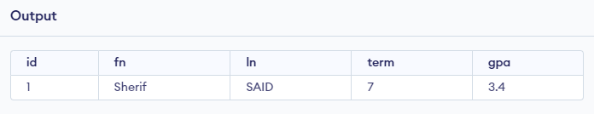
INSERT data into new TABLE student
INSERT INTO student VALUES (1,"Sherif","SAID",7,3.4);
SELECT * FROM student;
Original Table

Slide 26
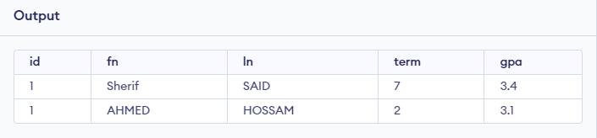
Problem :ID duplication
INSERT INTO student VALUES (1,"Sherif","SAID",7,3.4);
INSERT INTO student VALUES (1,"AHMED","HOSSAM",2,3.1);
SELECT * FROM student;
Original Table

Slide 27
Solution : Prevent ID duplication
Create TABLE IF NOT EXISTS student (id INTEGER PRIMARY KEY ,fn TEXT ,ln TEXT ,term INTEGER ,gpa REAL);
Original Table

Slide 28
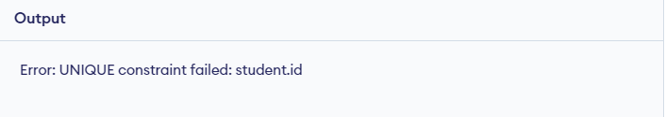
Solution : Prevent ID duplication
INSERT INTO student VALUES (1,"Sherif","SAID",7,3.4);
INSERT INTO student VALUES (1,"AHMED","HOSSAM",2,3.1);
Original Table

Slide 29
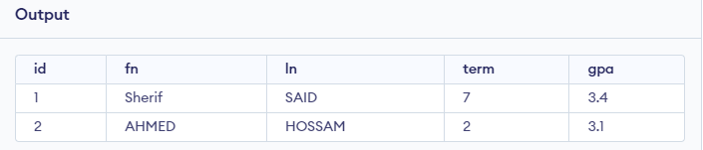
Solution : Prevent ID duplication
INSERT INTO student VALUES (NULL,"Sherif","SAID",7,3.4);
INSERT INTO student VALUES (NULL,"AHMED","HOSSAM",2,3.1);
SELECT * FROM student;
Original Table

Slide 30
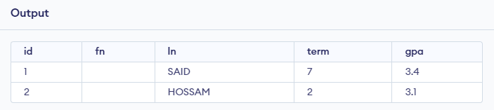
Problem : constraints on NULL
INSERT INTO student VALUES (NULL,NULL,"SAID",7,3.4);
INSERT INTO student VALUES (NULL,NULL,"HOSSAM",2,3.1);
SELECT * FROM student;
Original Table

Slide 31
Solution : constraints on NULL
Create TABLE IF NOT EXISTS student (id INTEGER PRIMARY KEY ,fn TEXT NOT NULL , ln TEXT NOT NULL ,term INTEGER ,gpa REAL);
Original Table

Slide 32
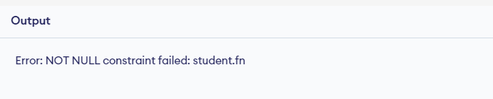
Solution : constraints on NULL
INSERT INTO student VALUES (NULL,NULL,"SAID",7,3.4);
INSERT INTO student VALUES (NULL,NULL,"HOSSAM",2,3.1);
Original Table

Slide 33
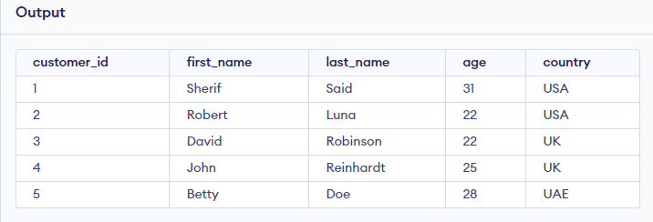
Update row in TABLE Customers
UPDATE Customers set first_name="Sherif" , last_name="Said" where customer_id =1;
SELECT * FROM Customers;
Original table

Slide 34
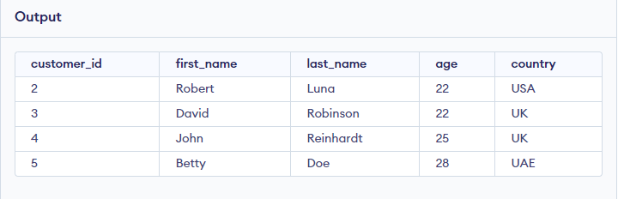
DELETE row in TABLE Customers
DELETE FROM Customers where customer_id =1;
SELECT * FROM Customers;
Original table

Slide 35
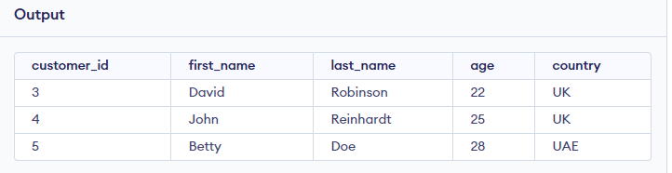
DELETE many rows in TABLE Customers
DELETE FROM Customers where customer_id IN (1,2);
SELECT * FROM Customers;
Original table

Slide 36
SQL Basics 2

Slide 37
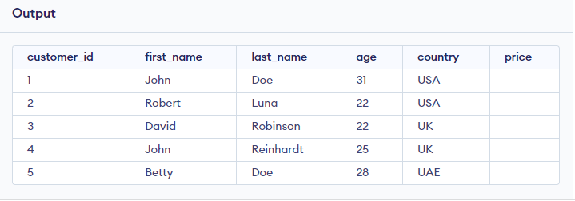
ADD new Column to TABLE Customers using ALTER
ALTER TABLE Customers ADD COLUMN price INTEGER;
SELECT * from Customers;
Original table

Slide 38
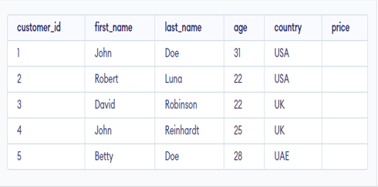
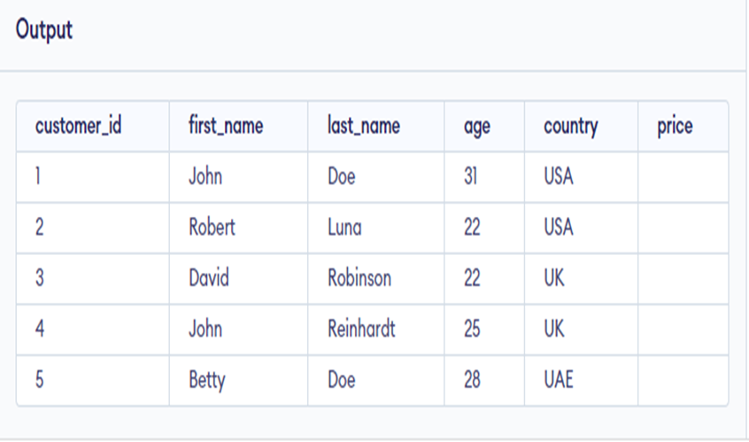
Change data type of column
ALTER TABLE Customers ALTER COLUMN age VARCHAR(2);
SELECT * FROM Customers;
Original table

Slide 39
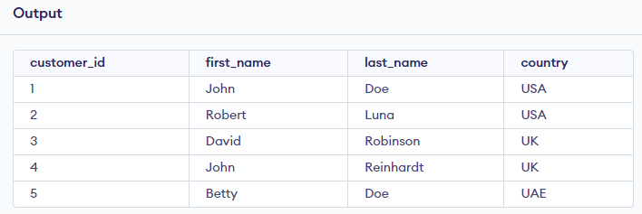
DROP COLUMN from TABLE
ALTER TABLE Customers DROP COLUMN age;
SELECT * FROM Customers;
Original table

Slide 40
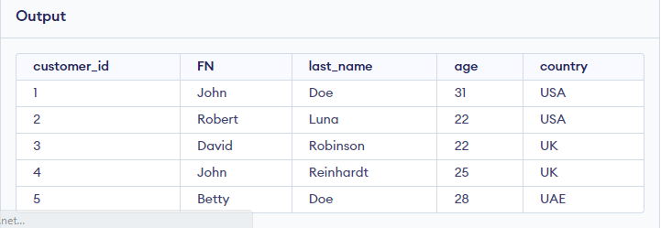
Change column name in a TABLE
ALTER TABLE Customers RENAME COLUMN first_name TO FN;
SELECT * FROM Customers;
Original table

Slide 41
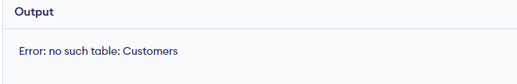
DROP TABLE
DROP TABLE Customers;
SELECT * FROM Customers;
Original table

Slide 42
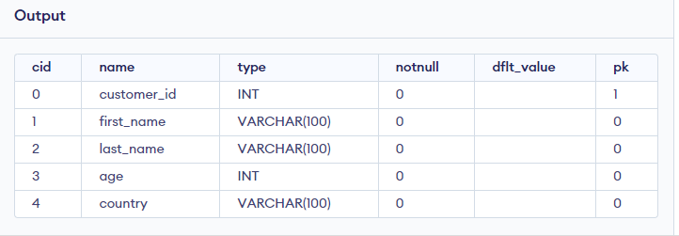
Get TABLE information ,columns names and data types
PRAGMA table_info('Customers');
Original table

Slide 43
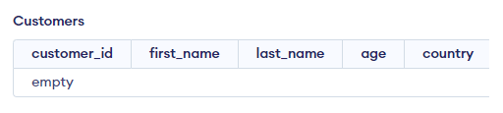
EMPTY the TABLE using TRUNCATE
TRUNCATE TABLE Customers IMMEDIATE ;
Original table

Slide 44
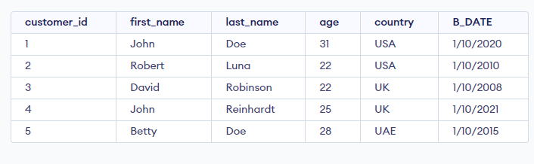
Create new column B_DATE and update the TABLE
ALTER TABLE Customers ADD COLUMN B_DATE DATE;
update Customers set B_DATE="1/10/2020" where customer_id = 1;
update Customers set B_DATE="1/10/2010" where customer_id = 2;
update Customers set B_DATE="1/10/2008" where customer_id = 3;
update Customers set B_DATE="1/10/2021" where customer_id = 4;
update Customers set B_DATE="1/10/2015" where customer_id = 5;
OUTPUT

Slide 45
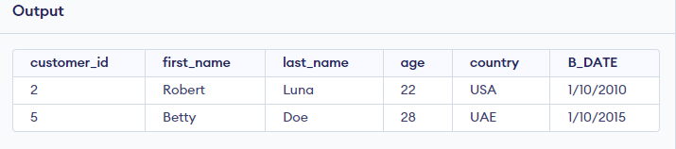
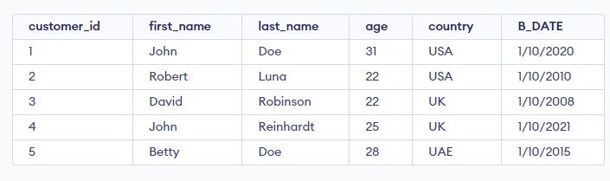
Using String Patterns LIKE to get all data in 201X
SELECT * FROM Customers where B_DATE LIKE '%201%' ;
Original table

Slide 46
SQL Advanced

Slide 47
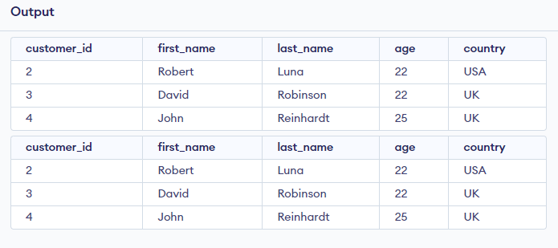
Using between ….and
SELECT * FROM Customers where customer_id >=2 AND customer_id <=4;
SELECT * FROM Customers where customer_id BETWEEN 2 AND 4;
Original table

Slide 48
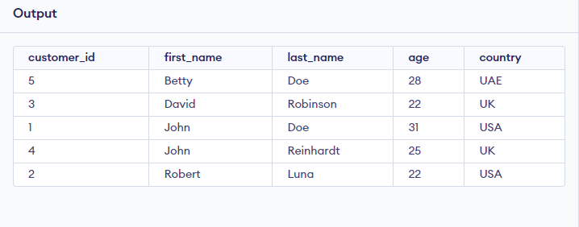
Using ORDER … BY to sort data
SELECT * FROM Customers ORDER BY first_name;
Original table

Slide 49
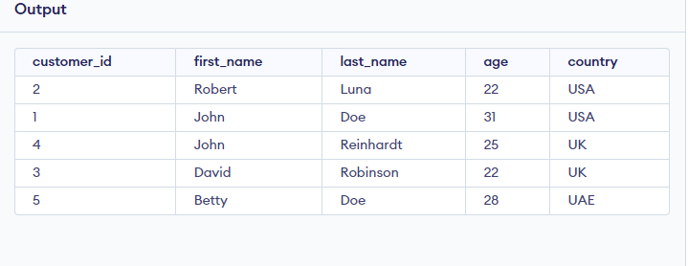
Using ORDER … BY …DESC to sort data in descending
SELECT * FROM Customers ORDER BY first_name DESC;
Original table

Slide 50
Using ORDER … BY to sort data by using column number
SELECT * FROM Customers ORDER BY first_name;
SELECT * FROM Customers ORDER BY 2;
Original table

Slide 51
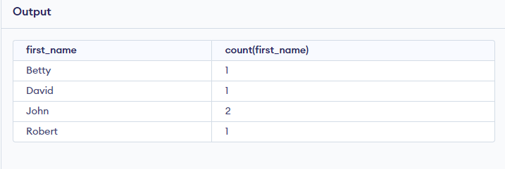
Using group by 1
SELECT first_name,count(first_name) FROM Customers group by first_name
Original table

Slide 52
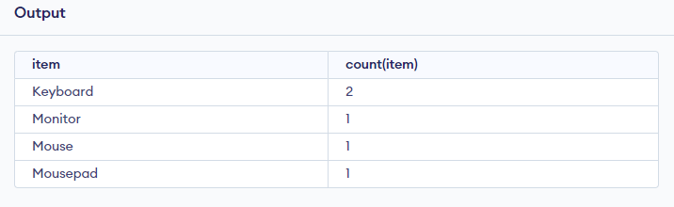

Using group by 2
SELECT item , count(item) FROM Orders group by item
Original table

Slide 53

Using group by 3
SELECT customer_id,count(customer_id) FROM Orders group by customer_id
Original table

Slide 54

Using group by 4
SELECT customer_id,count(customer_id) as order_count FROM Orders group by customer_id
Original table

Slide 55

Using group by …. having
SELECT customer_id,count(customer_id) as order_count FROM Orders group by customer_id having count(customer_id) >= 2
Original table

Slide 56

Using group by with avg function sorted with average
SELECT item,count(item) as item_count , avg (amount) as average FROM Orders group by item order by average
Original table

Slide 57

Using group by with avg function sorted with average having average more than 300
SELECT item,count(item) as item_count , avg (amount) as average FROM Orders group by item having average > 300 order by average
Original table

Slide 58

Using sum function
SELECT sum(amount) as amount_sum from orders;
Original table

Slide 59

Using sum function with group by
SELECT item , sum(amount) as amount_sum from orders group by item;
Original table

Slide 60

Create new column item_price
ALTER TABLE orders ADD COLUMN item_price REAL;
update orders set item_price = 10 where order_id =1;
update orders set item_price = 5 where order_id =2;
update orders set item_price = 50 where order_id =3;
update orders set item_price = 10 where order_id =4;
update orders set item_price = 2 where order_id =5;
Original table

Slide 61


Get total price for every item using multiplication
SELECT amount * item_price as total_price FROM Orders;
Original table

Slide 62

Get total price for every item using multiplication
SELECT item,amount * item_price as total_price FROM Orders;
Original table

Slide 63

Get sum of prices for all items
SELECT sum(amount * item_price) as total_price FROM Orders;
Original table

Slide 64

Get sum of prices with group by for every item
SELECT item,sum(amount * item_price) as total_price FROM Orders group by item;
Original table

Slide 65

Get max price for all items
SELECT item,max(amount * item_price) as total_price FROM Orders ;
Original table

Slide 66

Using group by with avg function
SELECT item,count(item) as item_count , avg (amount) as average FROM Orders group by item
Original table

Slide 67

Using function LENGTH with strings
select length(first_name) from customers;
Original table

Slide 68

Using function LENGTH with where
select * from customers where length(first_name) <=4;
Original table

Slide 69

Using UPPER with strings
select UPPER(first_name) from customers;
Original table

Slide 70

Using LOWER with strings
select LOWER(first_name) from customers;
Original table

Slide 71

Using lower to search for a string
select * from customers where LOWER(first_name) =='john';
Original table

